Slide 1
Proper Serial Port Communications in LabVIEW

Slide 2



Tim Robinson
Test Engineer in the Cincinnati, Ohio area
Using LabVIEW since 2005
forums.ni.com: crossrulz
Linkedin: http://www.linkedin.com/in/crossrulz
https://github.com/crossrulz/SerialPortNuggets

Slide 3
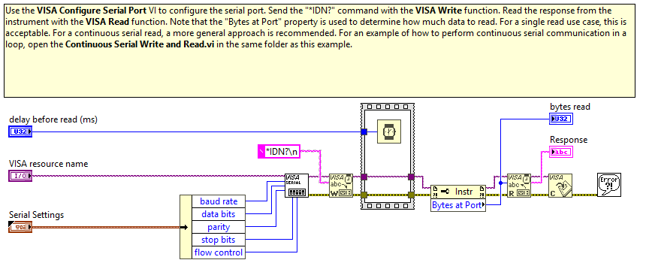
Simple Serial Example
Notes:
Issues with Simple Serial example:
Assumes SCPI protocol
Have a race condition with the instrument due to the Wait and the Bytes At Port

Slide 4
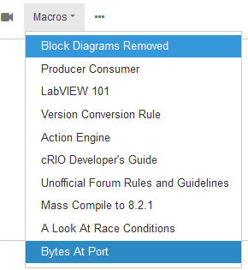
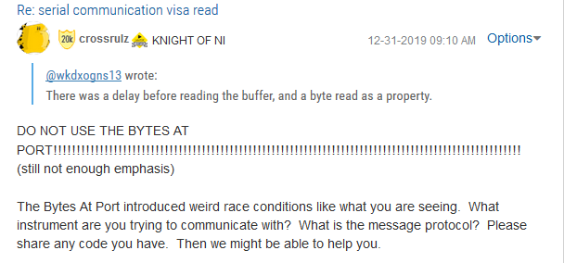

Slide 5
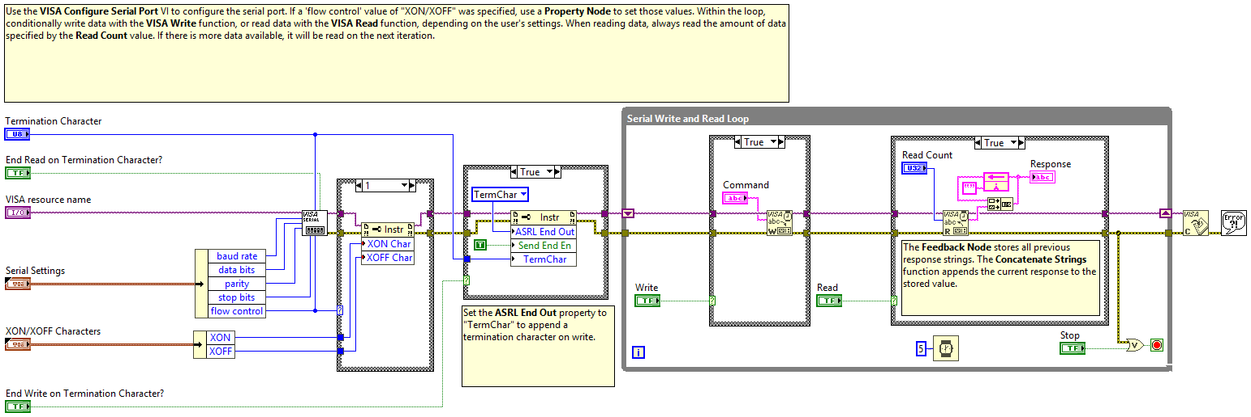
Continuous Serial Write and Read Example
Notes:
Issues with Continuous Serial Write and Read example:
Continuously growing response string
ASRL End Out really should not be used
XON and XOFF is used so infrequently it is borderline noise for an example
If data is not coming in, you will get timeout errors on the read, causing massive delay in application response

Slide 6
Determine Your Data Protocol
 |  | When
 |  | Response | Stream | Intermittent
Data Format | ASCII
 | Raw/Binary/Hex

Slide 7
When
Response
Only sends data when requested
Most bench instruments (DMM, Oscilloscope, Power Supply, etc)
Serial process
Stream
Data is constantly sent, typically at a set rate
Most home developed devices (Arduino)
Read must be done in parallel to constantly read data - avoid buffer overflow
Intermittent
Data is sent at indeterminate times (ex: on value change, on button press) or at a “slow” rate (>1 second)
Instruments that only care about changes in data
Similar to stream, but need to handle when no data available
Can be used for Response and Stream reads

Slide 8
Data Format - ASCII
You can read all of the data in a simple text editor
SCPI is used by most bench instruments
Typically a value followed by a Carriage Return and/or Line Feed – Termination Character
Arduino – use Serial.println() to add the termination character

Slide 9
Data Format - ASCII
VISA Read Stop Conditions – When ANY condition is met
Read the number of bytes commanded to read
The termination character is read (if enabled)
Neither condition is met within the timeout period (default 10 seconds)
Conclusion:
Enable termination character (default on VISA Configure Serial Port)
Read more bytes than you expect in a single message

Slide 10
Data Format - ASCII
CODE

Slide 11
Data Format – Raw/Binary/Hex
You need a hex editor/viewer to understand
The data protocol is essential to read the data properly
Typical message frame:
Start Byte – commonly 0x02 (Start of Text)
Message ID – way to identify what the message is
Data Size – number of bytes in the data, may also be defined by Message ID
Data – to be interpreted based on Message ID
Checksum or CRC – ensure data was correct

Slide 12
Data Format – Raw/Binary/Hex
CODE

Slide 13
Serial Communications
Questions?
https://github.com/crossrulz/SerialPortNuggets
https://labviewwiki.org/wiki/VIWeek

